Slide 1
Big Mountain Resort Problem Statement
Before the ski season begins, how can Big Mountain Resort identify comparable mountains (and their respective average ticket price) and better understand which facilities drive increased pricing (and which could thus be eliminated)?
H
1
Context
4
Constraints within solution space
Big Mountain Resort is a premium ski resort located in Montana, offering spectacular views and a world class winter sports experience for skiers and snowboarders. In addition to investing in new chair lifts, BMR has created a data science team to inform pricing strategies that more accurately reflect the value of their facilities (rather than the market premium strategy currently employed) and to better understand which BMR facilities deliver customer value / ROIC, and how to eliminate costs.
There is a large number of possible explanatory variables which could obfuscate key variables
Data is missing data on number of tickets purchased, which limits the understanding of pricing effectiveness.
5
Stakeholders to provide key insight
2
Criteria for success
Prior to the beginning of the ski season, BMR needs to determine an appropriate ticket price and identify area of investment / opportunities to cut costs over the next 1-3 years via lift/facility closures.
Jimmy Blackburn – Director of Operations
Alesha Eisen – Database Manager
3
Scope of solution space
BMR will need to narrow down the list of 330 resorts to those that have similar facilities to get a better sense of ticket prices within their market segment. BMR will need to identify which facilities correlate with higher ticket prices in order to inform their pricing strategy, identify future areas of investment / facilities that could potentially be closed down. This could likely be accomplished via multivariate regression analysis with ticket prices as dependent variable
6
Key data sources
CSV file provided by Alesha Eisen
H
D
E
I
P
Notes:
Hypothesis: Create a Hypothesis with an emphasis on SMART principles. (S – Specific, M – Measurable, A – Achievable, R – Realistic, T – Timebound). If you cannot do this, you do not have a good grasp on the business problem.
Context: With context, we have clearly identified the problem at hand and have elucidated on how our initiative may solve this problem, alongside the commercial implications this will have on the business.
Criteria for Success: Clearly defining the criteria for success ensures that the scope of your work is clearly defined and understood. Otherwise, if this isn’t defined – your work will never end which will result in mismatched expectations.
Scope of Solution Space: Scoping out the solution space ensures that the business initiative is SPECIFIC for a certain segment or area. This prevents solutions that have been developed being scaled and applied for all other business units that the solution may not be responsible or scalable for.
Constraints within Solution Space: Looking forward, what are the foreseeable problems we are likely to encounter? Could this be stakeholder resistance? Could this be we don’t have access to the right data?
Stakeholders to provide key insight: Who are the people I need to speak to, to get the answers I need for my data analysis?
What key data sources are required?
Based off my discussions with the key stakeholders – can we clearly list out all the data sources we need so we can make a highly targeted request as opposed to a scatter-gun approach where we ask for a bit of everything?

Slide 2
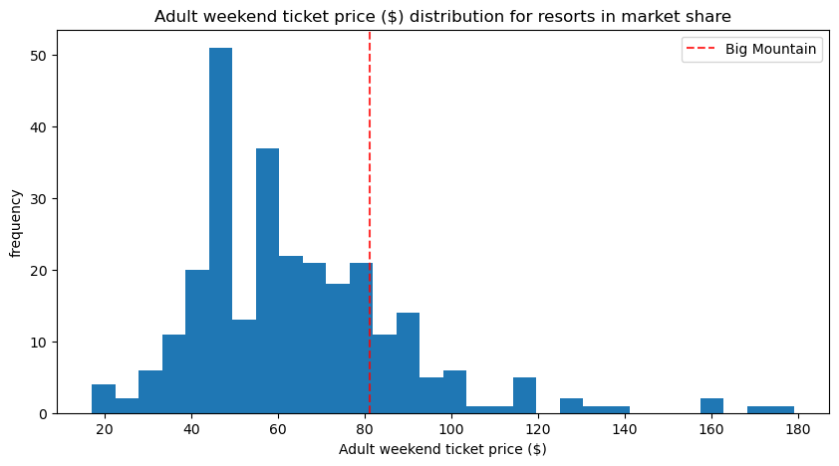
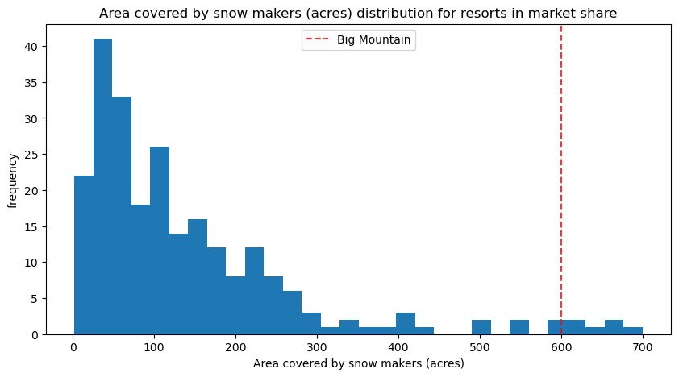
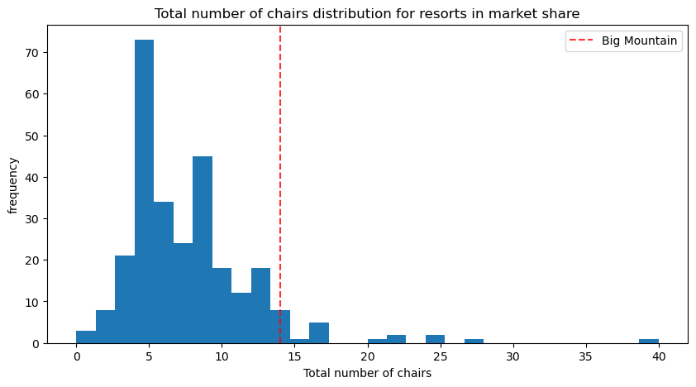
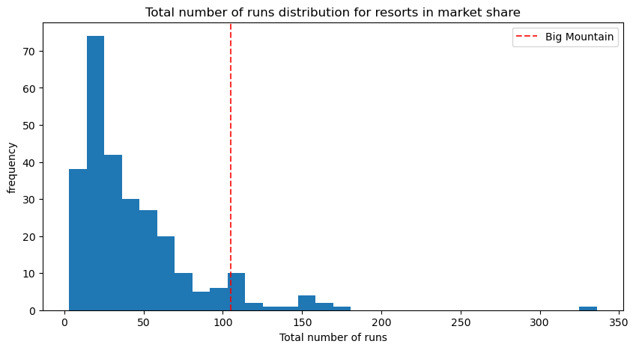
Recommendation and key findings
Recommendation: Increase ticket prices by ~$15/ticket to $96/ticket
Key Findings: Big Mountain Resort is a premium resort and needs to be priced accordingly, nearly all metrics with statistically significant import on ticket prices towards top of range

Slide 3
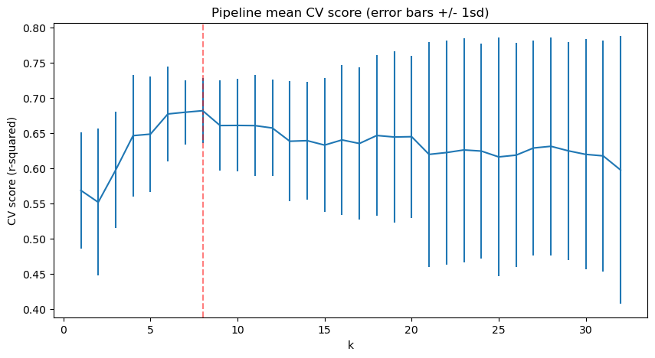
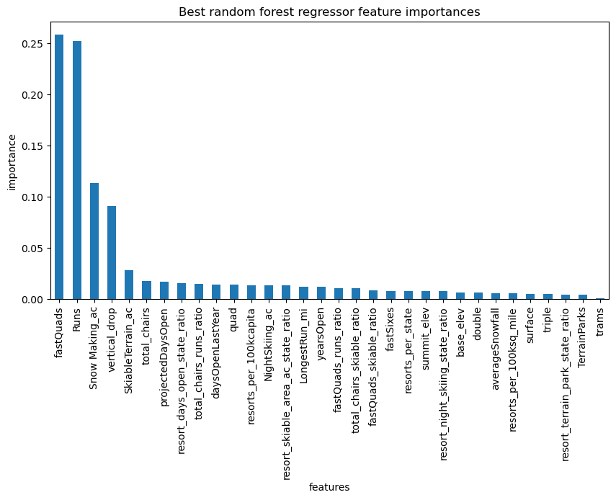
Modeling results and analysis
8 parameters yields the highest mean CV score for our Random Forest Model
Parameters with the highest feature importance included in the model are:
‘fastQuads’, ‘Runs’, ‘Snow Making_ac’, ‘vertical_drop’, ‘skiableTerrain_ac’, ‘total_chairs’, ‘projectedDaysOpen’, ‘resort_days_open_state_ratio’

Slide 4
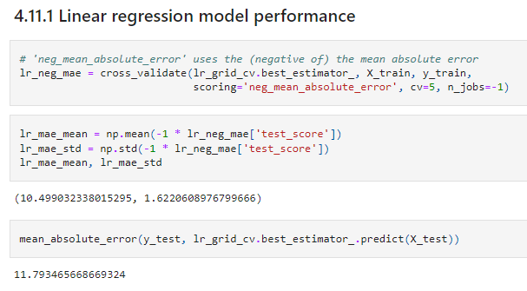
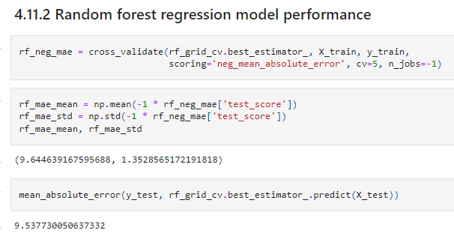
Modeling results and analysis (cont)
Our Random Forest regression model performs better than a simple linear regression

Slide 5
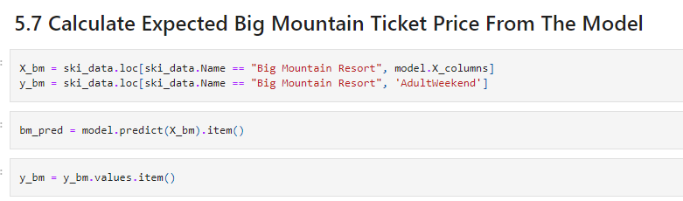
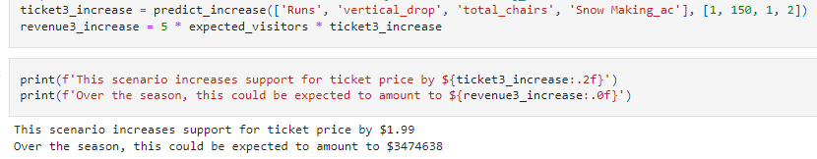
Modeling results and analysis (cont)
Our model calculates expected ticket price for BMR = $95.87 (vs actual $81.00) with an MAE of $10.39 and implies adding a chair such that runs/vertical drop/snow making acreage increase by 1/15/2, respectively could boost tickets another $1.99

Slide 6
Summary and conclusion
To conclude, our model supports increasing ticket prices by ~$15
fastQuads’, ‘Runs’, ‘Snow Making_ac’, and ‘vertical_drop’ are the four variables with the greatest feature importance in our model, indicating they should be the focus of potential expansion projects
It is worth exploring the NPV of scenarios 1-4 depicted in our modeling work, particularly the addition of chairs for the purpose of increasing runs/snow making/vertical drop

